Slide 1

Diversity and inclusion
June 2024
Notes:
Background notes for the teacher
This power point presentation supports the information found in the Sexuality Teaching Kit for Grade 9 to 12.
Each slide throughout the presentation has suggested speaking notes, meant as a guide, to help cover the content and facilitate discussion with students.
*This power-point presentation and speaker notes are for educator use only.
This power point is divided into five sections. Each section can be taught independently.
Diversity and Inclusion
Puberty Review
Healthy Relationships
Contraception
Sexually Transmitted and Blood-Borne Infections (STBBIs)
It is recommended that the class establish ground rules. Include in the introduction discussion that no judgement is passed during these conversations. Remind students that we are sharing information, not telling them what to do, so they can make healthy and informed decisions for themselves now and in the future.
It is important to make a conscious effort to include gender inclusive language throughout these discussions in order to support all students who are learning about this important health topic.
For more detailed information than what is found in the power point please refer to the binder in the Grade 7 & 8 Sexuality Teaching Kit.
See below for additional recommended websites:
Egale Canada www.egale.ca
Canadian Centre for Gender and Sexual Diversity www.ccgsd-ccdgs.org
The Get Real Movement www.thegetrealmovement.com
The Gegi Project www.gegi.ca
The Society of Obstetricians and Gynaecologists of Canada (SOGC)www.sexandu.ca
Kids Help Phone www.kidshelpphone.ca
Alberta Health Services www.teachingsexualhealth.ca
SOGI 1 2 3 https://www.sogieducation.org/

Slide 2
How would you create a welcoming
and safe classroom environment?
Notes:
Brainstorm with the class different ideas and thoughts they believe would help to create a safe and welcoming classroom environment.
It is important that we all contribute to creating a positive school environment where everyone feels safe, comfortable and accepted.
Some important things to keep in mind when creating a welcoming and safe classroom environment include:
Treat everyone with respect. It's important for everyone to feel safe and included.
Set and revisit expectations/ground rules with the class.
Use neutral and inclusive language (ex: using gender neutral pronouns).
Do not make assumptions.
Being sensitive to all individuals (ex: asking questions, talking).
Find out what’s important to the learners.
Need to recognize biases.
A great resource to use to help create a classroom that is welcoming and encourages gender diversity is: Gegi’s Tips for Creating a Classroom that Welcomes and Sustains Gender Diversity: Gegi's Tips for Welcoming Gender Diversity in Your Classroom
Teach as though there is always gender diversity in the room.
Show, not just tell, your students and their loved ones that you are here for this.
Honour all students as the authority on who they are, starting with their names.
Maintain a resource binder with a loud and proud label, and display it in a prominent place in the classroom.
Begin to see your classroom through a gender lens.
Position students as active participants in creating and sustaining your community.
Notice and change the language you use.
Practice using gender-neutral pronouns before you have a student who has a gender-neutral personal pronouns.
Make a space for *every* student’s relationship with their gender to be voiced and explored (whether they are transgender or not).
Practice articulating that one of your legal responsibilities is mitigating gender-based discrimination in your classroom and school.
Defend your gender diversity-affirming practices through connection, not polarization (1).

Slide 3
What does 2SLGBTQI+ stand for?
Notes:
“An acronym that stands for Two-spirit, Lesbian, Gay, Bisexual, Trans, Queer, Questioning, and Intersex. This is a community that represents a diverse population of individuals. This acronym is often used as an umbrella term to encompass a much wider range of identities and experiences related to sex, gender, and attraction that fall outside the dominant norms of heterosexual and cisgender identities” (2).
There are also many variations of this acronym.
For individual definitions on each of these terms check out this resources: LGBTQI2S Terms and Concepts: https://egale.ca/awareness/terms-and-concepts-updated/

Slide 4
What is assigned sex?
Biological classification of a person as female, male, intersex or other.​
Based on visual assessment of external anatomy.
Notes:
“Assigned sex = the biological classification of a person as female, male or intersex. It is usually assigned at birth based on a visual assessment of external anatomy”(2).
Amaze.org has a variety of videos. *Preview video(s) to ensure alignment with curriculum.
Optional video: Sex Assigned at Birth and Gender Identity: What is the Difference? (3:45min) https://amaze.org/?topic=gender-identity
Intersex = “a person whose chromosomal, hormonal, or anatomical sex characteristics fall outside the conventional classifications of male and female” (2)
For individual definitions on each of these terms check out this resources: LGBTQI2S Terms and Concepts: https://egale.ca/awareness/terms-and-concepts-updated/

Slide 5
What is gender identity?
How an individual sees themselves, their internal sense of being female, male, both, or something else.
Some common terms related to gender identity include: agender, cisgender, genderfluid, nonbinary, transgender, etc.
Notes:
Gender Identity: “a person’s internal and individual experience of gender. It is not necessarily visible to others and it may or may not align with what society expects based on assigned sex. A person’s relationship to their own gender is not always fixed and can change over time”(2).
Amaze.org has a variety of videos. *Preview video(s) to ensure alignment with curriculum.
Optional video: Range of Gender Identities (2:55min) https://amaze.org/?topic=gender-identity
For individual definitions on each of these terms check out this resources: LGBTQI2S Terms and Concepts: https://egale.ca/awareness/terms-and-concepts-updated/

Slide 6
What is gender expression?
How an individual expresses themselves and shows their gender to others.
Some common terms related to gender expression include: androgynous, feminine and masculine.
Notes:
Gender Expression: “the way gender is presented and communicated to the world through their clothing, speech, body language, hairstyle, voice and/or the emphasis or de-emphasis of body characteristics and behaviours” (2).
Amaze.org has a variety of videos. *Preview video(s) to ensure alignment with curriculum.
Optional video: Expressing Myself. My Way. (3:36min) https://amaze.org/?topic=gender-identity
For individual definitions on each of these terms check out this resources: LGBTQI2S Terms and Concepts: https://egale.ca/awareness/terms-and-concepts-updated/

Slide 7
What is sexual orientation?
Based on how an individual feels or is attracted towards others.
Some common terms related to sexual orientation include: asexual, bisexual, demisexual, gay, heterosexual, lesbian, and pansexual.
Notes:
Sexual Orientation: “Attraction = often referred to as a sexual orientation, attraction describes a person’s potential for emotional, spiritual, intellectual, intimate, romantic and/or sexual interest in other people and may form the basis for aspects of one’s identity and/or behaviour”(2).
Amaze.org has a variety of videos. *Preview video(s) to ensure alignment with curriculum.
Optional video: What is Sexual Orientation? (1:59min) https://amaze.org/?topic=sexual-orientation
For individual definitions on each of these terms check out this resources: LGBTQI2S Terms and Concepts: https://egale.ca/awareness/terms-and-concepts-updated/

Slide 8
Components of Human Identity
Assigned Sex
Gender Identity
Gender Expression
Attraction
Notes:
Go to this link for a downable version of this visual tool: https://egale.ca/awareness/the-genderbread-person/
This is a visual tool to help understand these 4 components of human identity (in which all individuals posses):
Assigned Sex
Gender identity
Gender Expression
Attraction
There are many terms that are associated with each of these categories, and some of them fall into more than one category.
It’s important to note that the many varying identities and expressions exist on a continuum and are always evolving.
Another example of a visual that identifies these components is The Gender Unicorn: https://transstudent.org/gender/ (3)

Slide 9
What are pronouns?
“are words used to refer to a person other than their name”⁽⁴⁾
Here are some examples of different pronouns:
  He/him/his
  She/her/hers
  They/them/theirs
If you don’t know someone's pronoun, just ask!
Notes:
“Pronouns are words used to refer to a person other than their name”(4).
For example, “Have you heard from Stacey? She hasn’t responded to my texts today.
She is the pronoun
“it is a respectful and inclusive practice to use gender neutral pronouns, they/them/theirs, when referring to any person whose pronouns you do not yet know, until you are able to find out”(4).
It's important and respectful to use a person’s self-determined pronoun, rather than assuming what their pronouns are. If you don’t know what their pronouns are, just ask!
Helpful Resource - Pronoun Usage Guide: https://egale.ca/awareness/pronoun-usage-guide/

Slide 10
Instead of saying:
husband/wife, boyfriend/girlfriend
Say this instead:
partner/spouse/significant other
Inclusive language
Affirming and inclusive language
Instead of saying:
they use to be male/want to be female
Say this instead:
She is female/was assigned male at birth
Affirming language
Notes:
“Everyday language is often unnecessarily gendered. By shifting towards inclusive language, we can contribute to a more affirming environment that respects the gender identities of all people.
Pronouns and names are not the only parts of language marked by gender. Always be mindful of your assumptions and consider gender-neutral ways of communicating the same phrases. These tips are especially important in instances where you are referring to a general audience or don’t know the gender of the people you are speaking to.
Remember that you cannot tell someone’s gender identity by the way they look, so it is best not to assume.
Inclusive language is inclusive for everyone, not just the 2SLGBTQI people.
It is best practice to use gender-neutral language when addressing a general audience or people you do not know.
Affirming language is a great way to demonstrate allyship.
It is okay to make mistakes! Learn from them and commit to doing better the next time”(5)

Slide 11
What are some sources of support for someone who has questions about their gender identity and sexual orientation?
Notes:
Brainstorm with the class different sources of support.
Examples:
Talking to peers (who may be going through and feeling the same way)
School guidance counsellors
Health professionals
Trusted adults and friends
Clubs and alliances
It’s important that the students know that they are NOT alone.
Below is a list of local supports and resources:
Say out loud. A group for open minded youth. It offers a safe place for Lesbian, Gay, Bisexual, Transgender and questioning youth to connect, seek support, develop new friendships, express themselves, learn about the LGBTQ community and most importantly, have fun. (Belleville – 613-985-9650)
Spectrum. A safe and supportive space for 2SLGBTQI+ youth to hangout, make new friends, enjoy activities and discussions with peers, etc. (Quinte West – 613-392-6946)
Discover YOUth. An all-inclusive safer space for 2SLGBTQI+ youth and their allies. Regularly host guests from our local queer community and beyond. Often do art projects and workshops while discussing our challenges and successes. (Prince Edward County – 613-476-5962)
TRANSforum Quinte. Offers safe, confidential, free support and recreational group for transgender individuals, questioning or transitioning. (705-313-5124)
KCHC Transgender Health Care: https://kchc.ca/weller-avenue/transgender-health- care/
Belleville Pride: https://bayofquintepride.ca/
Rainbow Caregivers Network. A peer support group for people who care for individuals who identify within the LGBTQ+ community (eg. Parents, grandparents, teachers or care providers). (613-849-4641)
Other supports
LGBT Youth Line www.youthline.ca
Trans Lifeline www.translifeline.org
Kids Help Phone www.kidshelpphone.ca

Slide 12
Questions?
Notes:
Encourage students to speak with a trusted adult regarding any questions or concerns related to the content covered in the presentation.

Slide 13
References
Diversity and inclusion
Airton L, Kirkup K. Gegi’s tips for creating a classroom that welcomes and sustains gender diversity [Internet]. Ontario: Gregi.ca 2022 [cited 2022 Jul 6]. Available from: https://www.gegi.ca/wp-content/uploads/2021/04/Gegis-Tips-for-Welcoming-Gender-Diversity-in-Your-Classroom.pdf
Hui A. LGBTQI2S terms and concepts [Internet]. Toronto, ON: Egale; 2022 [cited 2022 Jun 1]. Available from: https://egale.ca/awareness/terms-and-concepts-updated
Pan L, Moore A. The Gender unicorn [Internet]. Trans Student Educational Resources; 2015 [cited 2022 Jul 14]. Available from: http://transstudent.org/gender/
Forde K. Pronoun usage guide [Internet]. Toronto, ON: Egale; 2022 [cited 2022 Jul 6]. Available from: https://egale.ca/awareness/pronoun-usage-guide/
Forde K. Affirming and inclusive language [Internet]. Toronto, ON; Egale. 2022 [cited 2022 Jul 6]. Available from: https://egale.ca/awareness/affirming-and-inclusive-language/

Slide 14
Healthy relationships
June 2024
Notes:
Background notes for the teacher
This power point presentation supports the information found in the Sexuality Teaching Kit for Grade 9 to 12.
Each slide throughout the presentation has suggested speaking notes, meant as a guide, to help cover the content and facilitate discussion with students.
*This power-point presentation and speaker notes are for educator use only.
This power point is divided into five sections. Each section can be taught independently.
Diversity and Inclusion
Puberty Review
Healthy Relationships
Contraception
Sexually Transmitted and Blood-borne Infections (STBBIs)
It is recommended that the class establish ground rules. Include in the introduction discussion that no judgement is passed during these conversations. Remind students that we are sharing information, not telling them what to do, so they can make healthy and informed decisions for themselves now and in the future.
It is important to make a conscious effort to use gender inclusive language throughout these discussions in order to support all students who are learning about this important health topic.
For more detailed information than what is found in the power point please refer to the Sexuality Teaching Kit.
In addition, recommended websites for additional information include:
The Society of Obstetricians and Gynaecologists of Canada (SOGC) www.sexandu.ca
Kids Help Phone www.kidshelpphone.ca
PREVNet www.prevent.ca
Addressing Youth Dating Violence www.youthdatingviolence.prevent.ca
Youthline www.youthline.ca
Teen Talk www.teentalk.ca
Sieccan www.sieccan.org
Media Smarts www.mediasmarts.ca
Alberta Health Services www.teachingsexualhealth.ca
Sexual Assault Centre for Quinte & District https://www.sacqd.com/

Slide 15
Many components
impact who we are
The Sexuality Wheel - Teachers | Teaching Sexual Health
Notes:
Suggested/optional speaking notes
Review the interactive sexuality wheel with students to discuss the many parts that make up and influence who we are. Emphasize that the wheel depicts the parts being interconnected and influence one another.
When it comes to making decisions regarding sexual health there are many things to consider.
Mind – someone’s emotions, thoughts and feelings. Does a certain decision lead to feelings of fear, worry, anxiety, anger, sadness, guilt? Do both partners have a common understanding of each other’s values.
Body – this is the physical stuff – risk of unintended pregnancy and STBBIs. We will talk more in-depth about the physical part in next set of slides.
Spirit – a person’s values and beliefs, what is important to them. Values are an important component to making decisions. Values are personal and what a person considers to be most important to them. Taking time to think about personal values can help when making important choices. Personal values are first taught by parents/caregivers and they can be influenced by many factors such as: family, peers, culture, religion, the media and personal experience.
Refer to the Sexuality Teaching Kit, Healthy Relationship section for additional information.

Slide 16
Healthy relationships share these in common:
feeling safe, honesty, open communication, mutual respect, acceptance, enjoyment.
Notes:
There are many types of relationships that individuals engage in from social to intimate relationships. Relationships are multi-layered and navigating relationships and the interactions we have with others can be challenging at times.
Understanding the differences between healthy and unhealthy relationships is important for students to know now and in the future.
Being in a healthy relationship should make each person feel good about themselves.
Open and honest communication is a key ingredient to a healthy relationship. It is important for each person to understand the other person's needs and expectations.
Healthy relationships with a partner shares these things in common:
feeling safe
honesty
open communication
mutual respect
acceptance
enjoyment (1)
Review the Building Healthy Relationships poster from PREVNet found here: https://www.prevnet.ca/wp-content/uploads/2024/10/Building-Healthy-Relationships-tdvam.pdf
Review the 8 Warning Signs of Unhealthy Relationships poster from PREVNet found here: https://www.prevnet.ca/wp-content/uploads/2024/02/8-Warning-Signs-Unhealthy-Relationships-tdvam.pdf
Review the How to Ask for Help poster from PREVNet found here: https://www.prevnet.ca/wp-content/uploads/2024/02/How-to-Ask-for-Help-tdvam.pdf

Slide 17
Communication is key
Effective communication allows an individual to share their ideas, thoughts, needs, wants etc.
Open, honest and respectful communication can take practice, but it is important to build the knowledge and skills to be healthy and safe now and in the future.
Types of communication
assertive
aggressive
passive
Notes:
Review with students the content on the slide.
Let's take a closer look at communication.
Discuss the three different types of communication styles and brainstorm what communication would look, sound and feel like for each of three communication styles.
Reiterate with students that gaining confidence with respectful communication that reflects one’s values and decisions takes practice.
Video clips from The Fourth R Strategies for Healthy Youth Relationships. There are several clips to choose from throughout Part 1, 2 and 3 of The Fourth R Skills for Effective Relationships videos. Below are some pre-selected scenarios, however educators need to preview any video first to ensure it is appropriate for their students.
Grade 9 Skills for Effective Relationships Part 1:
The following videos can be used to support discussions of communication styles. They
demonstrate one scenario with three different endings portraying assertive, passive
and aggressive communication styles.
https://youthrelationships.org/pages/grade-9-skills-for-effective-relationships-part-1
Some suggested video titles reviewing the three different communication styles:
Scenario 1 Pressure to send a picture of a friend from a party
Scenario 2 Choosing a partner over friend
Scenario 5 Accusation of partner cheating
Scenario 7 Rumors about cheating on partner
Scenario 16 Accusation of cheating on partner (2)
Grade 9 Skills for Effective Relationships Part 2:
The following video can be used to support discussions of skills related to delay, refusal and
negotiation. The video demonstrates one scenario with three different endings portraying
the three different skills; delay, refusal, negotiation.
https://youthrelationships.org/pages/grade-9-skills-for-effective-relationships-part-2
Scenario 15 Pressure to engage in sexual behaviour (3)
Grade 9 Skills for Effective Relationships Part 3:
The following video’s can be used to support discussions of the combinations of skills reviewed
in the previous two sets of videos. They demonstrate one scenario with three different endings portraying the combination of communication styles and skills.
https://youthrelationships.org/pages/grade-9-skills-for-effective-relationships-part-3
Scenario 1 Sexual pressure to take relationship to the next level (4)

Slide 18
mutual
enthusiastic
ongoing
Consent is…
specific
voluntary
sober
Consent-Tipsheet-FINAL.pdf (prevnet.ca)
Notes:
(Supports Gr. 7 D1.3 Gr.8 D2.2)
When talking about healthy relationships it is important to discuss Consent – as a protection for people emotionally, spiritually and physically.
Consent is a necessary element in a healthy relationship, and it is important we create and model a culture of consent.
Having individuals view situations through a lens of consent demonstrates respect and builds healthy relationships.
Recommend using this tip sheet found here https://www.prevnet.ca/wp-content/uploads/2024/02/Consent-Tipsheet-FINAL.pdf to generate discussion on consent and boundaries.
Review with students that
“Consent is:
Mutual (both parties clearly agree)
Enthusiastic (there is a desire and excitement)
Ongoing (it can be retracted at any time; it is a process, and it must be confirmed every step of the way)
Specific (it is clear what activity a person is consenting to)
Voluntary (it is given freely, not under pressure, and the person involved is the one consenting)
Sober (the parties involved are not under the influence of alcohol or drugs)” (8)
Alcohol and drugs can decrease inhibitions, weaken judgement and take away a person’s authentic self.
*Preview the video(s) on the next slide prior to showing the class. These videos explain consent and what is needed to give consent.

Slide 19
Tea and consent video (clean) (2:50min)
Understanding consent video (3:02 min)
Alberta Health Services, Teaching Sexual Health
What is consent? video (1:45 min)
Kids Help Phone
Notes:
*Recommended to preview the suggested videos before showing students.
Tea and Consent video (2:50 min) https://www.youtube.com/watch?v=fGoWLWS4-kU
Other suggested videos on consent:
Understanding Consent video (3:02 min) Alberta Health Services, Teaching Sexual Health. Available from: Understanding Consent - Teachers | Teaching Sexual Health
What is consent? Video (1:45 min) Kids Help Phone, available from: https://kidshelpphone.ca/get-info/video-what-consent/
Debrief the content in the video(s) and discuss the key components of consent such as:
-Consent must be given each time.
-A person can change their mind.
-Actively seek consent.
-The person must be sober.
-Consent cannot be forced.
-Verbal “yes” but body language is not matching does not mean consent.
-The absence of “no” does not mean “yes”.
If it doesn’t feel right – it probably isn’t. If someone is not sure –that’s ok. If a person’s instincts are telling them it’s not the right time, it probably isn’t.
Know what you want ahead of time – set boundaries – what will you accept and what you are okay with and what you are not okay with. It can be helpful to write it down and re-visit it.
Open and honest communication is very important. If a person can’t talk about their feelings, what they want, what they are ready for, their personal boundaries related to delaying sexual activity until later in life etc. then careful re-consideration is important.
Knowing and respecting oneself is important before being involved with someone else and is an important foundation to a healthy relationship.

Slide 20
Consent
What it looks like, sounds like, feels like.
Notes:
Refer to the Sexuality Teaching Kit, Healthy Relationships section, Consent activity.
To start the conversation about consent a good place to begin is to review the definition.
Consent can be defined as: “Consent is a mutual verbal, physical, and emotional agreement that happens without manipulation, threats, or coercion” (8)
In pairs or small groups, have students brainstorm and discuss scenarios where consent is needed.
e.g.:
• borrowing someone’s personal belongings
• posting a picture of a friend to your social media
• sharing information about someone to a mutual friend
• partners have been dating for awhile and one partner has said they were not ready to show affection by kissing, but at that moment decided it would be ok
In pairs or small group have students practice communicating consent by taking turns being the person initiating asking for consent and the person responding.
CONSENT SOUNDS LIKE
Next, have students practice how to ask for consent.
Some suggestions
• Is this okay?
• Do you like this?
• Are you comfortable with this?
• How do you feel about this?
• What do you like?
Have students practice different ways of responding including responses of giving consent and responses of not giving consent.
CONSENT FEELS LIKE
Bring the group back together and have students discuss and share:
How did it feel to ask for consent? Was it easy, challenging?
How did it feel to hear yes responses and no responses?
How did it feel to respond with giving consent or not? Was it easy, challenging?
Did you notice anything about verbal and non-verbal communication? Did they match?
Remember! It is important to respect the answer that is given. We all have a part to play in creating a culture of consent.

Slide 21
Activity
Is it consent?
http://teentalk.ca/consentgame/
Notes:
Using the following link, spin the wheel to review which responses are giving consent and which responses are not consent.
http://teentalk.ca/consentgame/
To support discussions around consent and the law, review Respect Sexual Consent, resource from the RCMP which can be found here: https://www.rcmp-grc.gc.ca/wam/media/2797/original/1d6b7a33e7e16bb452d1d28ae0df313a.pdf

Slide 22
Gender-based violence prevention
Notes:
Safety note: let your school administration team know you are talking about this in case any students come forward. Post the Kids Help Phone (1-800-668-6868 or text 686868) information in a visible place for any students who may need support.
Login to your Ophea account. Visit Home | Ophea.net Under Resources / Personal Safety and Injury Prevention select Access All. Scroll to find Gender-Based Violence Prevention Education Resources.
The Gender-Based Violence Prevention Education resources are very comprehensive and includes everything to help start and/or continue these important conversations that help equip students with the knowledge and skills to navigate if faced with similar scenarios.
Before you start
Under suggested content check out Ophea’s Gender-Based Violence Prevention Education 2022/2023 educator e-learning module to support deeper knowledge and confidence with discussing gender-based violence
Review the information included on the Getting Started tab found in the left side navigation bar
Recommend watching the three expert videos to increase awareness of this important topic area, including rationale for teaching strategies to implement and strategies to avoid. Each video is only several minutes long.
Why do we need to talk about consent and gender-based violence prevention in schools?
(Introduction to Sexual Violence Prevention 4:22 min)
Adopting a Consent-based Approach
(Introduction to Consent 5:55 min)
Tips for Constructive Classroom Conversations
(Creating Space for Constructive Classroom Conversations 4:23 min)
Recommend watching the video on Intersectional Approaches to Consent Education 8:39 min
Draw the Line Campaign: https://www.dtl.whiteribbon.ca/?gclid=Cj0KCQiA6Ou5BhCrARIsAPoTxrAbfiMgdC04XUvZ88j3SJALMvNnbRPMZ9Ab06GEp4HL1YPnzQJ-KaAaAvHSEALw_wcB
Activities:
Τhere are 7 Draw the Line activities in total. Each scenario includes a card with the scenario outlined on the front and further information on the back breaking down;
Why Draw The Line- background stats and context to the scenario
When to Draw The Line- possible red flags for sexual violence
How to Draw The Line- prompts or ways that someone could approach the scenario
A Video of same scenario that provides pauses in the video for reflection and discussion
Activity ideas and suggestions of how to cover the content, student worksheets etc.

Slide 23
Questions?
Notes:
Encourage students to speak with a trusted adult regarding any questions or concerns related to the content covered in the presentation.

Slide 24
References
Healthy Relationships
Sex & U. Types of relationships [Internet]. Ottawa, ON: The Society of Obstetricians and Gynaecologists of Canada; 2022 [cited 2022 Jul 14]. Available at: https://www.sexandu.ca/sexual-activity/types-of-relationships/
Youth Relationships. Grade 9 skills for effective relationships part 1 [Internet]. London, ON: Western University Centre for School Mental Health; 2022 [cited 2022 Jul 14]. Available from: https://youthrelationships.org/pages/grade-9-skills-for-effective-relationships-part-1
Youth Relationships. Grade 9 skills for effective relationships part 2 [Internet]. London, ON: Western University Centre for School Mental Health; 2022 [cited 2022 Jul 14]. Available from: https://youthrelationships.org/pages/grade-9-skills-for-effective-relationships-part-2
Youth Relationships. Grade 9 skills for effective relationships part 3 [Internet]. London, ON: Western University Centre for School Mental Health; 2022 [cited 2022 Jul 14]. Available from: https://youthrelationships.org/pages/grade-9-skills-for-effective-relationships-part-3
Public Health Agency of Canada. Consent: how you can support [Internet]. Canada: PREVNet; 2022 [cited 2023 January 26]. Available from: https://youthdatingviolence.prevnet.ca/wp-content/uploads/2021/12/Consent-Tipsheet-FINAL.pdf

Slide 25
Contraception
June 2024
Notes:
Background notes for the teacher
This power point presentation supports the information found in the Sexuality Teaching Kit for Grade 9 to 12.
Each slide throughout the presentation has suggested speaking notes, meant as a guide to help cover the content and facilitate discussion with students.
*This power-point presentation and speaker notes are for educator use only.
This power point is divided into five sections. Each section can be taught independently.
Diversity and Inclusion
Puberty Review
Healthy Relationships
Contraception
Sexually Transmitted and Blood-Borne Infections (STBBIs)
It is recommended that the class establish ground rules. Include in the introduction discussion that no judgement is passed during these conversations. Remind students that we are sharing information, not telling them what to do, so they can make healthy and informed decisions for themselves now and in the future.
It is important to make a conscious effort to include gender inclusive language throughout these discussions in order to support all students who are learning about this important health topic.
For more detailed information than what is found in the power point please refer to the Sexuality Teaching Kit.
In addition, recommended websites for additional information include:
The Society of Obstetricians and Gynaecologists of Canada (SOGC) www.sexandu.ca
Alberta Health Services www.teachingsexualhealth.ca
Kids Help Phone www.kidshelpphone.ca

Slide 26
Many components
impact who we are
The Sexuality Wheel - Teachers | Teaching Sexual Health
Notes:
Suggested/optional speaking notes
Before we move on and discuss contraception, remember our previous discussion regarding the many types of relationships that individuals engage in from social to intimate relationships. Relationships are multi-layered and navigating relationships and the interactions we have with others can be challenging at times.
Review the sexuality wheel with students to discuss the many parts that make up and influence who we are. Emphasize that the wheel depicts the parts being interconnected and influence one another.
When it comes to making decisions regarding sexual health there are many things to consider.
Mind – someone’s emotions, thoughts and feelings. Does a certain decision lead to feelings of fear, worry, anxiety, anger, sadness, guilt? Do both partners have a common understanding of each other’s values
Body – this is the physical stuff – risk of unintended pregnancy and STBBIs. We will talk more in-depth about the physical part in next set of slides.
Spirit – a person’s values and beliefs, what is important to them. Values are an important component to making decisions. Values are personal and what a person considers to be most important to them. Taking time to think about personal values can help when making important choices. Personal values are first taught by parents/caregivers and they can be influenced by many factors such as: family, peers, culture, religion, the media and personal experience.
“Data from Statistics Canada’s Canadian Community Health Survey indicate that 35% of Canadian youth reported experiencing first sexual intercourse before age 17” (1)
For the next section we will talk more specifically about pregnancy risk and discuss why protection is very important.
Refer to the Sexuality Teaching Kit for Grade 9-12, contraction section for additional information.

Slide 27
What is contraception?
Also known as birth control.
Any process, technique, device, or drug that interferes with conception is called contraception.
Notes:
Suggested/optional speaking notes:
Contraception is generally defined as any of several methods used to prevent pregnancy. Most methods prevent the sperm from uniting with the egg, by preventing ovulation or putting up a barrier. Some also prevent the fertilized egg from implanting in the uterus.
Amaze.org has a variety of videos. *Preview video(s) to ensure alignment with curriculum.
Optional video: https://amaze.org/?topic=pregnancy-and-reproduction
The Contraceptinator; Birth Control: What is it? (3:44min)
Birth Control: The Final Frontier (4:50min)

Slide 28
Abstinence or delaying sexual activity until later in life is:
a healthy and acceptable way to reduce risk of STBBIs.
an effective form of contraception for penis vagina intercourse (sex that could cause pregnancy).
Notes:
Suggested/optional speaking notes:
ABSTINENCE – Delaying sexual activity until later in life
"In relation to birth control, abstinence means not engaging in sexual activity — specifically sex that could cause pregnancy — to prevent the possibility of unplanned pregnancy." (2)
It’s important to make note that abstinence can mean different things to different people, so it is important that an individual is clear on what it means to them.
For example: for some people, it may mean abstaining from ANY form of activities of a sexual nature. For others it may mean refraining from specific activities such as vaginal, anal or oral intercourse.
It’s important to acknowledge that delaying sexual activity until later in life is a healthy and acceptable choice for people.
Amaze.org has a variety of videos. *Preview video(s) to ensure alignment with curriculum.
Optional video: https://amaze.org/?topic=pregnancy-and-reproduction
What is Abstinence? (2:42min)

Slide 29
Activity
What is abstinence?
Notes:
Refer to the Grade 9-12 Sexuality Teaching Kit, Contraception section, "What is abstinence" activity for additional information and activity suggestions.

Slide 30
How can a person protect themselves
if they choose to engage
in sexual activity?
Notes:
When someone considers becoming sexually active, it is important to remember the components of mind, body, spirit we talked about earlier in the Healthy Relationships unit.
Relationships can be complex; they are multi-layered and can be challenging at times.
When it comes to making decisions regarding sexual activity there are many things to consider:
Mind – someone’s emotions, thoughts and feelings. Does this decision lead to feelings of fear, worry, anxiety, anger, sadness, guilt?
Body – this is the physical stuff – risk of an unintended pregnancy and STBBIs.
Spirit – a person’s values and beliefs, what is important to them. Values are an important component to making decisions. Values are personal and what a person considers to be most important to them. Taking time to think about personal values can help when making important choices. Personal values are first taught by parents and caregivers, and they can be influenced by many factors such as: family, peers, culture, religion, the media and personal experience.
For the next section we will talk more specifically about pregnancy risk. Let’s discuss why protection is very important.

Slide 31
How many sperm are released in one ejaculation?
a few
200 – 300
thousands
hundreds of millions
Up to 500 million sperm in one ejaculation

Slide 32
On average, how long can sperm survive in the reproductive tract of someone with a vagina?
1 hour
12 hours
24 hours
3 days
d) 3 days

Slide 33
How many sperm does it take to fertilize one egg?
Notes:
See the next slide for the answer.

Slide 34
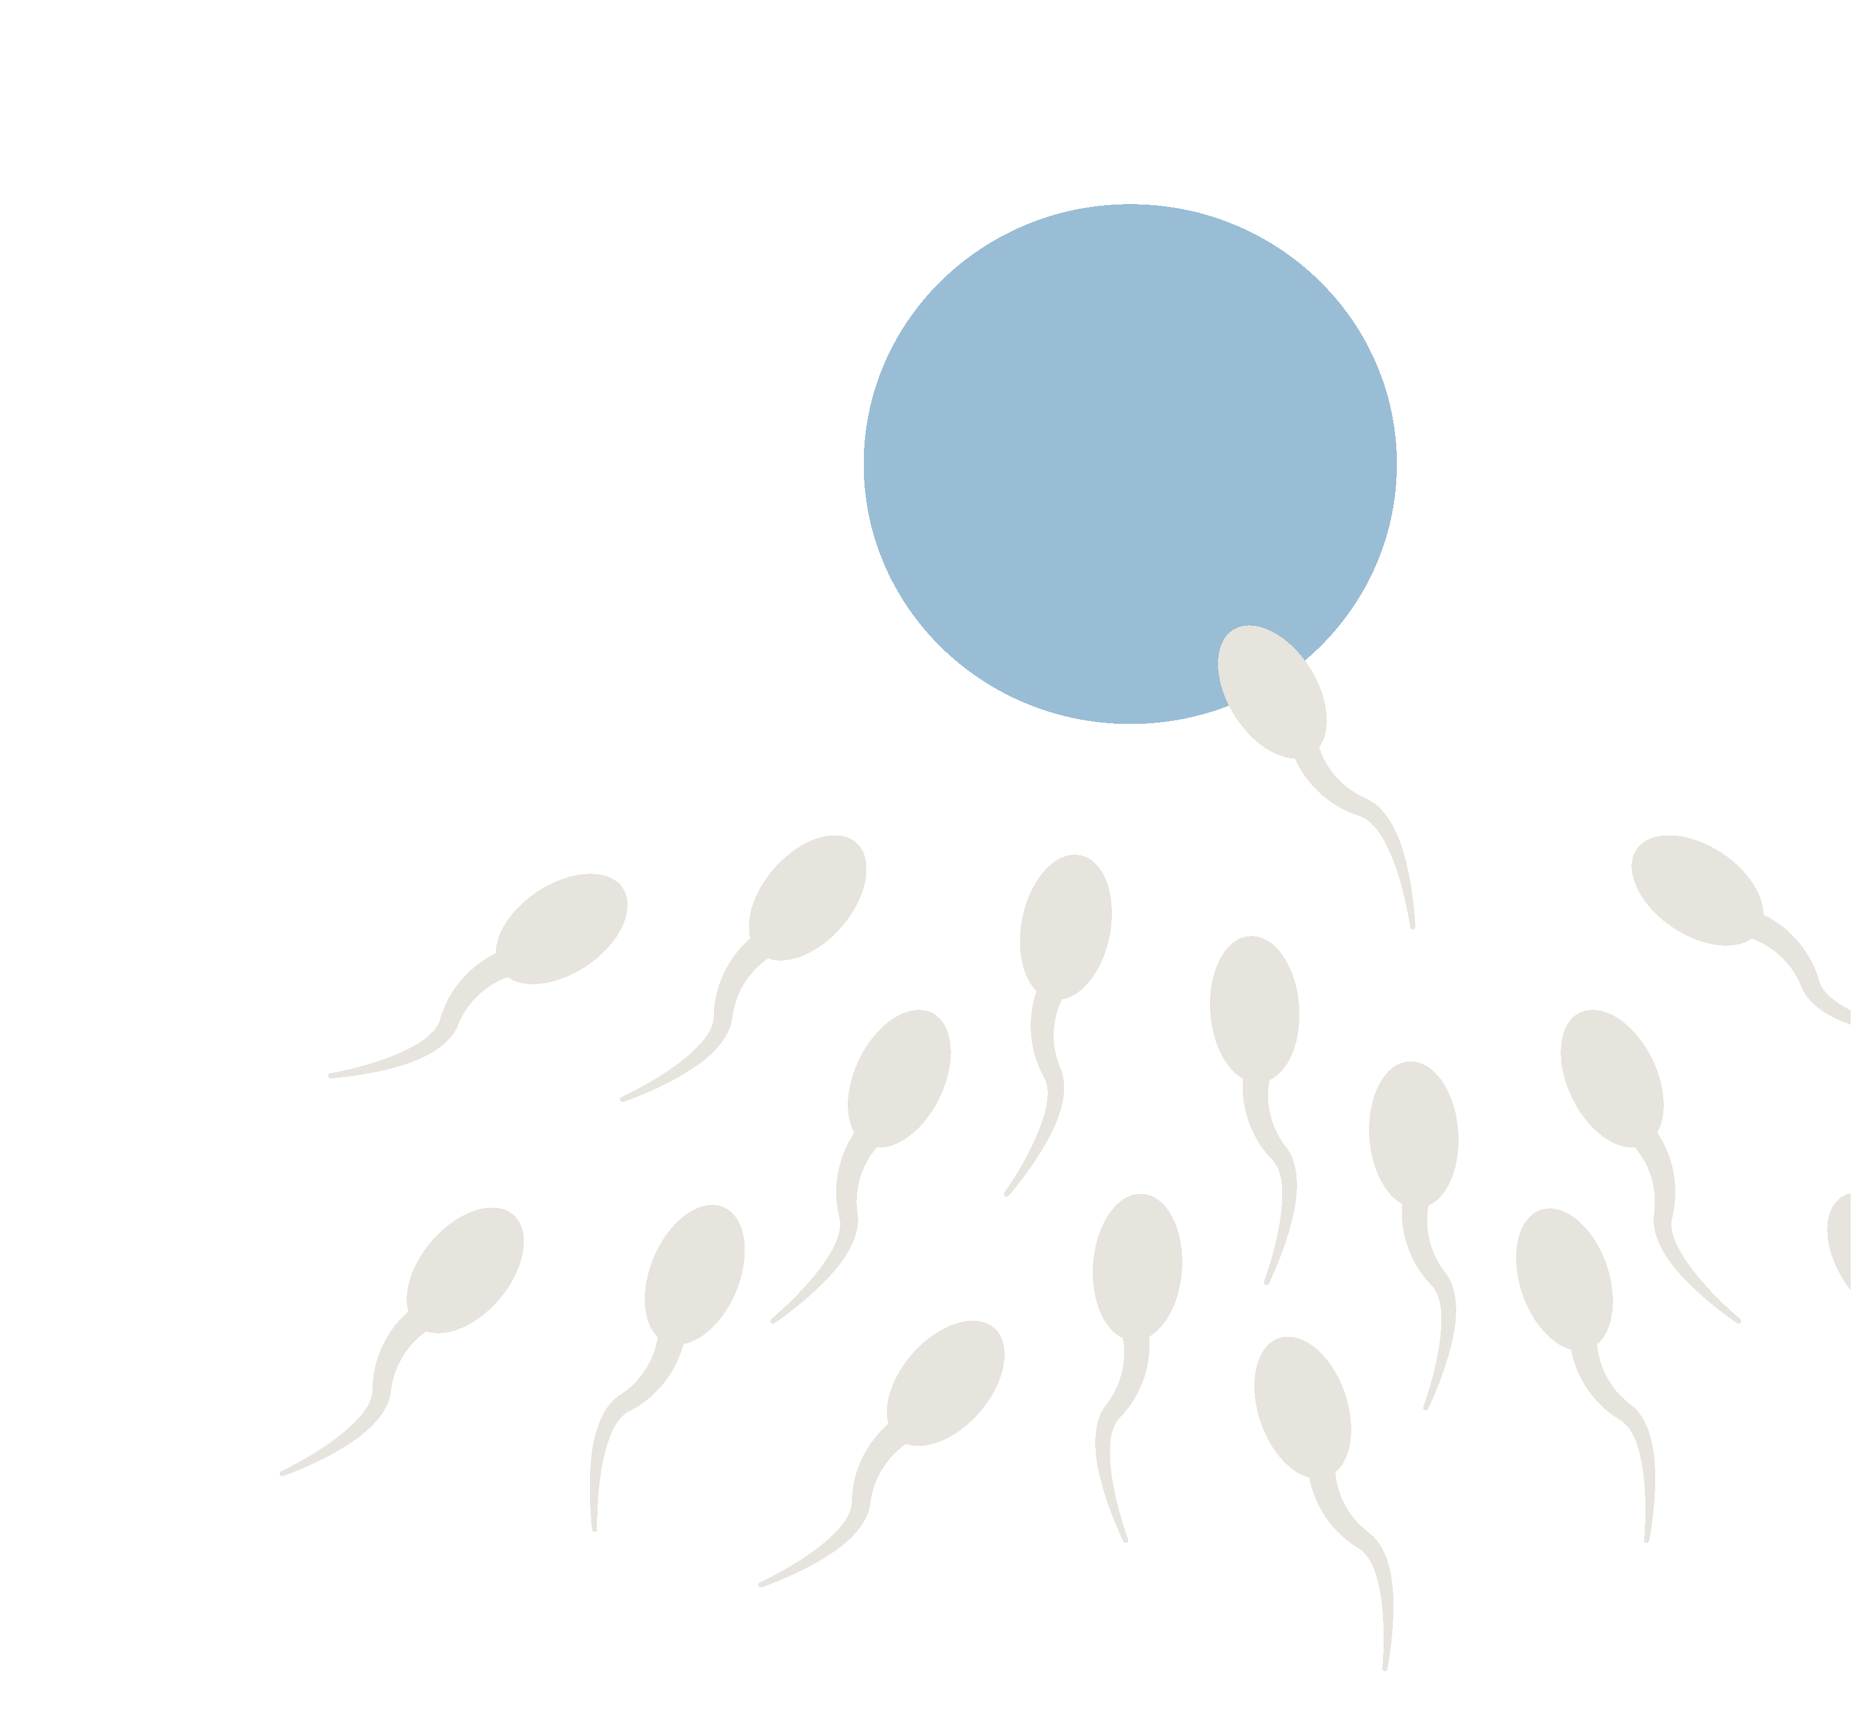
Fertilization
One – yes, that’s right!
One sperm fertilizes one ovum
Notes:
One sperm fertilizes one ovum
Fertilization occurs in the fallopian tubes
Review the last three slides with students – there are hundreds of millions of sperm in one ejaculation AND sperm can live on average up to 3 days(4) and some sources indicate up to 5 days(5) in the genital tract (of someone with a vagina) AND it only takes one sperm to fertilize one egg. Unprotected penis vagina intercourse is risky in terms of pregnancy.

Slide 35
Contraceptive methods
Hormonal methods
Non-hormonal methods
Birth control pills
Contraceptive patch
Vaginal Ring
Injectable contraception
Intrauterine contraception (IUC)
Contraceptive implant
External condom
Internal condom
Spermicidal foams, gels*
Intrauterine contraception (Copper IUC)
Sponge
Cervical cap
Diaphragm
All contraceptive methods must be used correctly
and consistently to be effective!
Notes:
Refer to the Grade 9-12 Sexuality Teaching Kit, Contraception section, for additional information background information on each of the contraceptive methods, contraceptive booklet explaining each method in more detail, and contraceptive samples.
Suggested/optional speaking notes:
Listed on this slide are some of the examples of hormonal and non-hormonal contraceptive methods (6).
There are many different contraceptive methods to choose from. It's important to note, that contraceptive methods have varying rates of effectiveness and there is no 100% safe, and effective contraceptive method.
When an individual(s) is considering becoming sexually active, it is a good idea to review what methods of contraception are available, the positive and negative factors associated with each, and consider them within the context of their personal situation.
Someone wanting to start contraception will be assessed and counselled on the best option for them.
In addition to hormonal and non-hormonal methods of contraception, there are also more permanent as well as natural methods:
Permanent methods include:
Vasectomy
Tubal ligation
Natural methods include:
Fertility-awareness based methods
Withdrawal
Lactational amenorrhea method (LAM)
Abstinence
For more information related to permanent and natural methods check out the Contraception Booklet on SexandU: https://www.sexandu.ca/wp-content/uploads/2021/05/SOGC_14372_Contraception_DownloadablePDF_ENG_WEB.pdf
***The next few slides will go through some of these contraceptive methods in more detail***

Slide 36
Hormonal methods
Must be prescribed by
a health care provider
Need a medical assessment – not a full physical exam but a medical history will be done
Possible pregnancy test
Blood pressure
Education
Hormonal methods of contraception
do NOT provide protection from STBBIs!
Notes:
Suggested/optional speaking notes:
Hormonal methods of contraception/birth control use synthetic hormones that mimic hormones that are naturally produced in the body – estrogen and progesterone to:
Stop the egg from ripening in the ovary
Stop ovulation from happening
Thicken the mucous around the cervix so sperm can’t penetrate
Prevent the lining of the uterus from thickening so an egg cannot successfully implant
When a person sees a doctor or nurse, a medical history will be taken – this is to make sure that the contraceptive method isn’t going to be harmful to their health. They will ask the person questions such as “When was your last period?”, “Are your periods regular?”, “Are you sexually active?”. Answering questions honestly helps to determine the best method of contraception and whether or not STBBI testing should be recommended. It is common for health care providers to do a pregnancy test, even if a person is not sexually active, and it is done by providing a urine sample in a cup.
Brainstorm with students what questions someone would want to prepare ahead of time and ask, for example:
will my parents/guardians find out?
how much does it cost?
how long will it be until I am protected from pregnancy?
what happens if I don’t use the method properly?
what are the side effects, if any? etc.

Slide 37
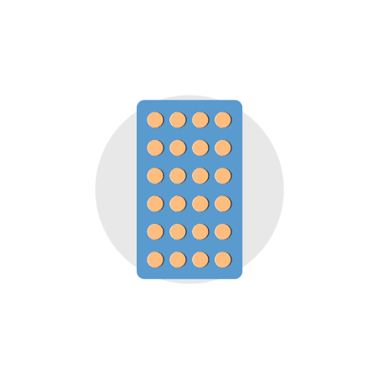


Hormonal methods
The pill, patch, and ring
Take every day, same time, typically for 3 weeks, then placebo or nothing for a week
Change every week,
3 weeks with patches,
then nothing for a week
Change every month,
in for 3 weeks,
then out for a week
Hormonal methods of contraception do NOT provide protection from STBBIs!
Notes:
Oral Contraceptive Pill
Must be taken at the same time every day (consider the difference in someone’s weekday and weekend schedules). Many packs come with 28 pills so that a person takes one pill everyday of the month, but the last row of pills are placebos designed to keep them on track with taking pills consistently, and do not actually contain hormones.
There are also packs of 21 pills, in which the last week there would be no pills to take.
There are a variety of contraceptive pills and a discussion with a healthcare provider is important to determine the best pill for the individual.
Contraceptive Patch
Worn on the skin for 1 week, then removed and replaced with a new patch. 3 patches are worn in a month, and then nothing for a week.
The patch can be placed on the buttocks, upper outer arms, lower abdomen, or upper torso (not on the breast).
Vaginal Ring
Flexible, and the sides are squeezed together to insert into a female’s vagina, then it expands to hold in place. It is left in for 3 weeks, then use a finger to pull it out. Use nothing for a week. There is an app to remind individuals when to put it in and take it out (6).

Slide 38

Hormonal methods
Depo-Provera injection
Every 3 months, Injection in the upper arm or buttocks,
Need to remember appointments
Hormonal methods of contraception do NOT provide protection from STBBIs!
Notes:
Depo-Provera
Injections are given four times a year, every three months, don’t have to remember to take pills but need to remember to come back for next injection,
given in upper arm or buttocks, long lasting, reliable, lighter periods or no period after being on this method for approximately 12 months (6).

Slide 39


Hormonal methods
IUC and implant
Inserted into the uterus by a HCP. Can remain in place for 5 years.
Inserted into the arm and can remain in place for 3 years.
Hormonal methods of contraception do NOT provide protection from STBBIs!
Notes:
Intrauterine Contraception (IUC)
Also referred to as IUD (Intrauterine device)
This a T-shaped device that is inserted & removed from the uterus by a health care provider (HCP)
Inserted every 5 years
Is a long lasting, reversable contraceptive method, safe, convenient and discreet
Contraceptive Implant
This contraceptive method was approved for use in Canada in May 2020 (it had been used in many other countries)
A 4 cm long flexible rod that is inserted into the arm (sitting just below the skin)
It is highly effective, reversible and long lasting
It’s inserted every 3 years
Inserted by a health care provider (HCP) using local anaesthetic to numb the skin (6).
Amaze.org has a variety of videos. *Preview video(s) to ensure alignment with curriculum.
Optional video: https://amaze.org/?topic=pregnancy-and-reproduction
Long-Acting Contraception Explained (2:13min)

Slide 40

Emergency contraception
Can be taken up to 5 days after unprotected sex, more effective the sooner it is taken
Emergency contraception does NOT
provide protection from STBBIs!
Notes:
Emergency Contraception
Also known as the morning after pill or Plan B.
Not a regular form of birth control.
“Emergency Contraception cannot interrupt an established pregnancy or harm a developing embryo” (7)
Emergency contraception works to prevent a pregnancy by temporarily delaying ovulation.
So basically, it stops the ovary from releasing an egg so that there is no egg available to meet the sperm.
No egg=No fertilization=No pregnancy.
Can be used if: someone is not on birth control, if someone is on the pill BUT misses a dose, forgets to apply a contraceptive patch or insert vaginal ring, or if oral contraceptive pill is not taken properly.
Can be taken up to 5 days after unprotected sex but the sooner the better. (7) Sperm can live on average up to 3 days (4) and some sources indicate up to 5 days (5) in the female genital tract.
Does not bring on menstruation, spotting may be experienced a few days later. The next menstrual period should come on time. If the period is more than a week late, the person should see their doctor.
! Important point to review with students after discussing the hormonal methods of contraception
Do any of these hormonal methods protect against STBBIs?
No

Slide 41
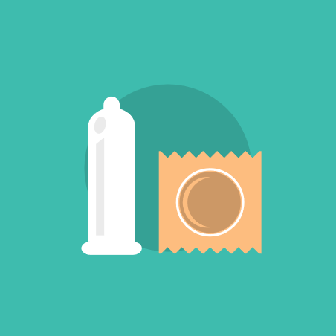

Non-hormonal barrier methods
External condom and internal condom
Condoms are the ONLY method of birth control
(other then abstinence) that protects against STBBIs.
Notes:
External condom (covers the penis) – also known as the male condom
Internal condom (inserted into the vagina or anus) – also known as the female condom
Barrier methods are inserted or applied before intercourse and provide a barrier or a block at the opening of the cervix, which prevents sperm from getting through the cervix.
Condoms are a barrier method of contraception and the only form of contraception, besides abstinence, that can provide protection from sexually transmitted and blood-borne infections (STBBIs). Using a condom correctly and consistently reduces the risk of STBBIs and pregnancy. We will review the steps for proper condom use on the next slide.
Barrier methods, such as condoms offer very good STBBI protection, however they do not protect against every STBBI, only what is covered by the condom. Some STBBIs can present anywhere in the ‘boxer short region’ i.e. Herpes, genital warts and can happen with skin-to-skin contact.
!IMPORTANT! Water based lubricants are the only safe lubricant to use with condoms. They can be found in the same section of the store as the condoms. DO NOT USE regular lotions, creams, petroleum or oil-based lubricants example Vaseline.
“Petroleum or oil-based lubricants should not be used with latex condoms. These substances weaken the latex and can lead to breakage” (8)
“Spermicidal lubricated condoms containing nonoxynol-9 (N-9) are not recommended for STBBI prevention because N-9 can increase the potential for transmission of STBBIs by causing disruptions and lesions in the genital and anal mucosa". (9)
Other examples of barrier methods are the diaphragm, cervical cap and sponge. These barrier methods would NOT be good protection against STBBIs. (6)

Slide 42
Activity
Condom steps
Notes:
Refer to the Sexuality Teaching Kit, Contraception section, Condom Activity for additional information and activity cards.

Slide 43
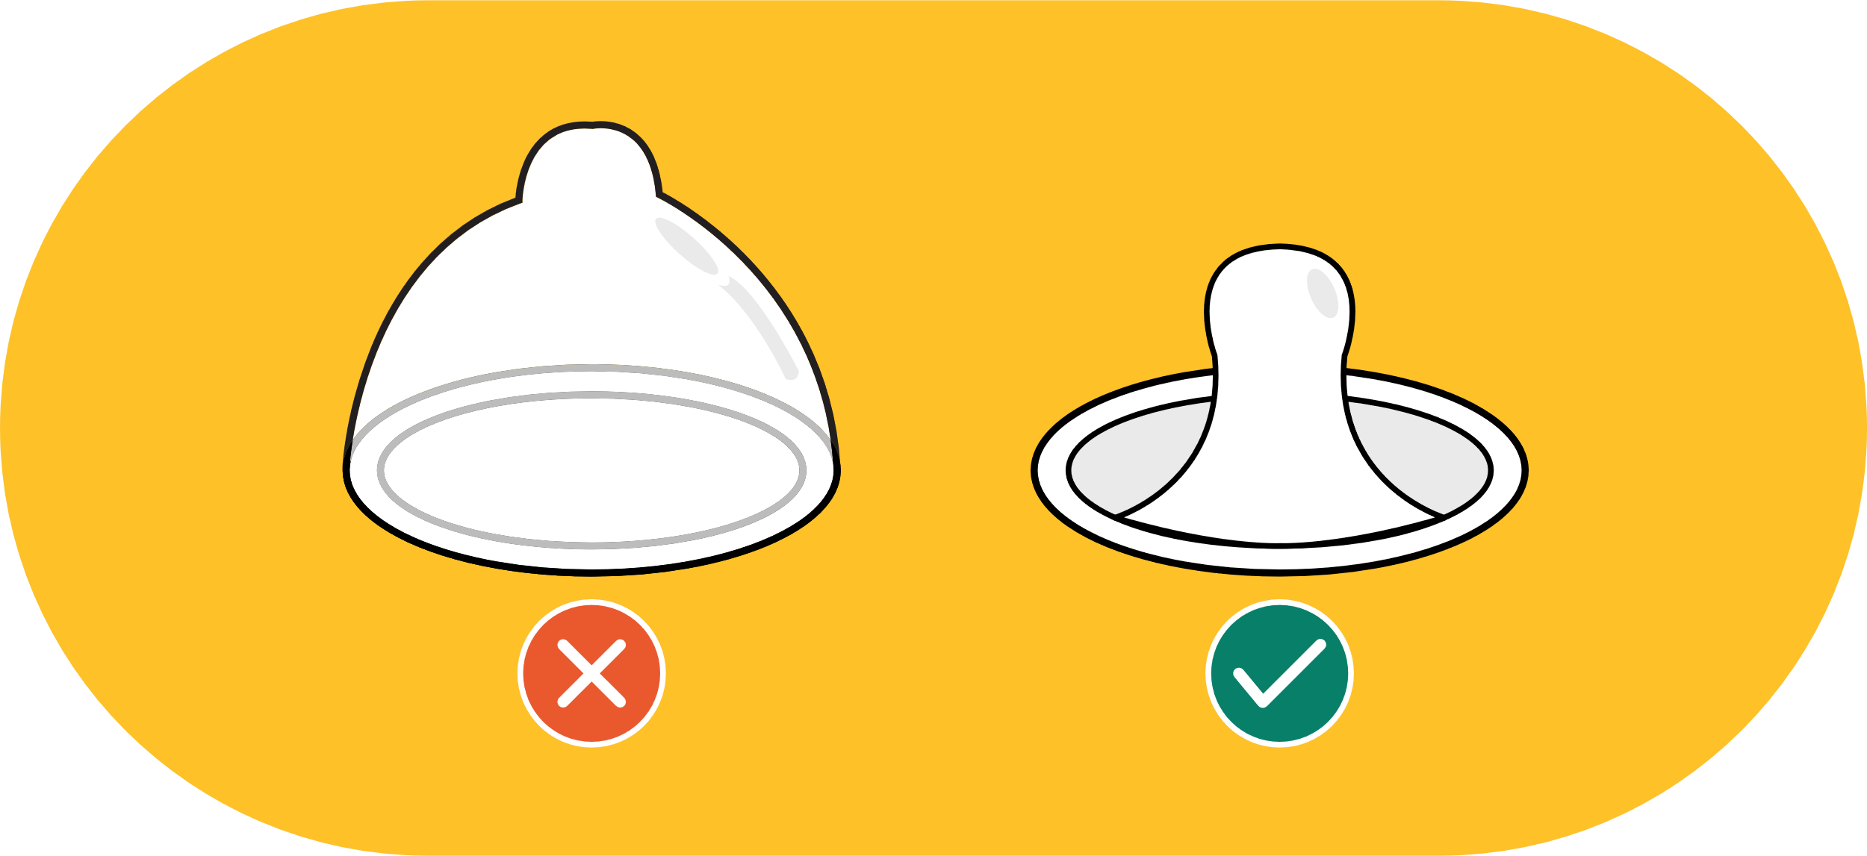
Steps for condom use
Purchase condoms
(and check expiry date on package).
Check expiry date on condom.
Check for holes or tears in package.
Open package carefully.
Press the air out of the tip of the condom.
Place condom (unrolled) on top of penis.
Carefully roll condom down over as much of the erect penis as possible.
After ejaculation, hold base of condom and withdraw.
Check and dispose of properly. Do not reuse.
*Consent should be ongoing and gained throughout the process (i.e., before, during and after).
Notes:
Review steps for proper condom use.
Optional Video: Teaching Sexual Health (Alberta Health Services): https://teachingsexualhealth.ca/teachers/resource/condom-demonstration-video/
Refer to the Sexuality Teaching Kit, Contraception section, Condom Game for additional information and activity cards.
Answers for proper order:
NOTE: Consent should be included at any point in the process as it should be ongoing (i.e. before, during and after activity)
1. Purchase condoms.
Available from drug stores, retail stores, sexual health clinics.
2. Check expiry date on condom.
Students often put this step before Purchase Condoms. Either order
is acceptable. Remind students to check expiry date every time.
The expiry date is written on each individual condom.
3. Check for holes or tears in package.
Store condom in a cool, dry place. Never in your wallet. Heat and
friction will break down condoms.
4. Open package carefully.
Use only water based lubricants.
5. Press the air out of the tip of the condom.
Pinching the end will create space for semen and help prevent
breakage.
6. Place condom (unrolled) on top of penis.
If you put a condom on the tip of the penis the wrong way, don’t just
flip it over—get a new one. It is the right way if it looks like a sombrero,
not a toque.
7. Carefully roll condom down over as much of the erect penis as
possible.
Never “double bag” condoms. Using more than one causes
friction and the condom is more likely to break.
8. After ejaculation, hold base of condom and withdraw.
Use a new condom for every sex act.
9. Check and dispose of properly. Do not reuse.
Wrap condom in tissue after use, and place in the garbage.
DO NOT flush.

Slide 44
Activity
Decision making scenarios
Notes:
Refer to the Sexuality Teaching Kit, Contraception section, Decision Making activity for two scenario worksheets and answer sheets.
This activity could be done as a small group activity or large group discussion.

Slide 45
Questions?
Notes:
Encourage students to speak with a trusted adult regarding any questions or concerns related to the content covered in the presentation.

Slide 46
References - Contraception
Sex Information and Education Council of Canada. Sexual health education in the schools: questions & answers updated 2015 Ontario edition [Internet]. Toronto, ON: Sex Information and Education Council of Canada; 2015 [cited 2022 Jul 14]. Available from: http://sieccan.org/wp-content/uploads/2018/05/SIECCAN-QA-Sexual-health-education-in-the-schools-2015-Ontario.pdf
Kids Help Phone [Internet]. Preventing pregnancy: Info about birth control & safe sex; 2023 [cited 2023 Jun 16]. Available from: https://kidshelpphone.ca/get-info/preventing-pregnancy-info-about-birth-control-safer-sex/
Hirsch L. Male reproductive system [Internet]. USA: Nemours TeensHealth; [reviewed 2019 Jul; cited 2019 Jul 26]. Available from: https://kidshealth.org/en/teens/male-repro.html?WT.ac=ctg#catchanging-body
The Society of Obstetricians and Gynaecologists of Canada. Before you conceive: human reproduction [Internet]. Ottawa, ON: The Society of Obstetricians and Gynaecologists of Canada; [cited 2019 July 26]. Available from: https://www.pregnancyinfo.ca/before-you-conceive/human-reproduction/the-basics-of-human-reproduction/
SexInfo Online. Biological Steps to Becoming Pregnant [Internet]. Santa Barbara: University of California; [updated 2017 Feb 15; cited 2019 Sep 9]. Available from: https://sexinfoonline.com/biological-steps-to-becoming-pregnant/
Sex & U. [Internet]. Contraception. Ottawa (ON): The Society of Obstetricians and Gynaecologists of Canada; 2022 [cited 2022 Jul 4]. Available from: https://www.sexandu.ca/wp-content/uploads/2021/05/SOGC_14372_Contraception_DownloadablePDF_ENG_WEB.pdf
World Health Organization. Emergency contraception [Internet]. Work Health Organization; [2021 Nov 9; cited 2019 Sep 9]. Available from: https://www.who.int/news-room/fact-sheets/detail/emergency-contraception
Government of Canada. Safer condom use. [cited 2019 September 10]. Available at: https://www.canada.ca/en/public-health/services/sexual-health/safer-condom-use.html
Government of Canada. Sexually transmitted and blood borne infections (STBBI) prevention guide [Internet]. Canada: Government of Canada; [modified 2022 Jun 21; cited 2022 Jul 12]. Available from: https://www.canada.ca/en/public-health/services/infectious-diseases/sexual-health-sexually-transmitted-infections/canadian-guidelines/stbbi-prevention-guide.html

Slide 47
Sexually Transmitted and
Blood-borne Infections
June 2024
Notes:
Background notes for the teacher
This power point presentation supports the information found in the Sexuality Teaching Kit for Grade 9 to 12.
Each slide throughout the presentation has suggested speaking notes, meant as a guide, to help cover the content and facilitate discussion with students.
*This power-point presentation and speaker notes are for educator use only.
This power point is divided into five sections. Each section can be taught independently.
Diversity and Inclusion
Puberty Review
Healthy Relationships
Contraception
Sexually Transmitted and Blood-Borne Infections (STBBIs)
It is recommended that the class establish ground rules. Include in the introduction discussion that no judgement is passed during these conversations. Remind students that we are sharing information, not telling them what to do, so they can make healthy and informed decisions for themselves now and in the future.
It is important to make a conscious effort to include gender inclusive language throughout these discussions in order to support all students who are learning about this important health topic.
This next section we will address STBBIs. For more information refer to the Sexuality Teaching Kit, Sexually Transmitted and Blood-borne Infections section for additional information and activities.
The use of STBBIs is used throughout this resource and refers to Sexually Transmitted and Blood-borne Infections (STBBIs) which are a group of infections that are primarily passed from person to person during unprotected sexual contact (vaginal, oral or anal sex). It also includes infections that can be spread through intimate contact (genital to genital skin contact), contact with infected blood or body fluids. Some STBBIs can also be spread to a baby during pregnancy or childbirth.
In addition, recommended websites for additional information include:
The Society of Obstetricians and Gynaecologists of Canada (SOGC) www.sexandu.ca
Alberta Health Services www.teachingsexualhealth.ca
Sex Information & Education Council of Canada www.sieccan .org
The Society of Obstetricians and Gynaecologists of Canada (SOGC) www.hpvinfo.ca
Public Health Ontario www.publichealthontario.ca

Slide 48
Many components
impact who we are
The Sexuality Wheel - Teachers | Teaching Sexual Health
Notes:
Suggested/optional speaking notes
Before we move on and discuss STBBIs, remember our previous discussion regarding the many types of relationships that individuals engage in from social to intimate relationships. Relationships are multi-layered and navigating relationships and the interactions we have with others can be challenging at times.
Review the sexuality wheel with students to discuss the many parts that make up and influence who we are. Emphasize that the wheel depicts the parts being interconnected and influence one another.
When it comes to making decisions regarding sexual health there are many things to consider.
Mind – someone’s emotions, thoughts and feelings. Does a certain decision lead to feelings of fear, worry, anxiety, anger, sadness, guilt? Do both partners have a common understanding of each other’s values.
Body – this is the physical stuff – risk of unintended pregnancy and STBBIs. We will talk more in-depth about the physical part in next set of slides.
Spirit – a person’s values and beliefs, what is important to them. Values are an important component to making decisions. Values are personal and what a person considers to be most important to them. Taking time to think about personal values can help when making important choices. Personal values are first taught by parents/caregivers and they can be influenced by many factors such as: family, peers, culture, religion, the media and personal experience.
Reinforce the importance of abstinence as a healthy, acceptable choice for young people.
“Data from Statistics Canada’s Canadian Community Health Survey indicate that 35% of Canadian youth reported experiencing first sexual intercourse before age 17” (1)
Now we will talk more specifically about STBBIs.
Refer to the Sexuality Teaching Kit, STBBI section for additional information.

Slide 49
How are STBBIs spread
Sexual contact
Intimate contact
Contact with infected blood
Notes:
The use of STBBIs refers to Sexually Transmitted and Blood-borne Infections (STBBIs) which are a group of infections that are primarily passed from person to person during unprotected sexual contact (vaginal, oral or anal sex). It also includes infections that can be spread through intimate contact (genital to genital skin contact), contact with infected blood or body fluids. Some STBBIs can also be passed to a baby during pregnancy or childbirth.
STBBIs can be spread in several ways
Sexual contact
-when an infected person has vaginal, anal or oral sex with another person.
-can be spread from body fluids such as semen (including pre-ejaculatory fluids), vaginal secretions, or from surfaces inside the throat, vagina and rectum.
Intimate contact
-Genital to genital touching/contact can also expose a person to STBBIs such as HPV, Herpes, pubic lice and scabies.
Contact with infected blood
-HIV, Hep B, Hep C are STBBIs that can be spread by blood-borne contact through:
-use of improperly sterilized needles, equipment used by someone with the infection for injection drug use, steroid use, tattooing, body piercing.
-sharing personal care items like razors, toothbrushes.
Who is at risk of contracting an STBBI?
-Anyone who engages in sexual activity (regardless of age, gender, background, identity) can contract an STBBI
-Highest risk is from unprotected vaginal and anal intercourse
-Other risk factors include:
-not knowing sexual partner
-having multiple partners
-partner who have history of multiple partners
-under influence of substances
-injection drug use
How to prevent STBBIs
-delay sexual activity until later in life
-use barrier protection correctly and consistently with each sexual activity
-vaccine to protect against Hep B and certain strains of HPV
-seek testing

Slide 50

Types of STBBIs
viral | bacterial | parasitic
human papillomavirus (HPV; genital warts) | chlamydia | scabies
herpes simplex virus (HSV; genital/oral herpes) | gonorrhea | trichomoniasis
hepatitis B | syphilis | crabs/pubic lice
HIV/AIDS
STBBIs caused by a virus have no cure, but there are effective treatments available.
STBBIs caused by a bacteria or parasite can be treated and cured with antibiotics
Notes:
Review the slide making note of the following regarding STBBIs:
-Categorized into the following 3 categories: Viral, Bacterial or Parasitic. Viral have no cure but can be treated. Bacterial can be treated and cured with antibiotics.
-Some infections are vaccine preventable (Hep B, HPV)
-Some are Blood-borne infections (Hep B, HIV)
Educator Note: Students knowing each STBBI in great detail is not imperative, instead knowing which category an STBBI belongs to, if they are curable or treatable, and how to prevent contracting and/or passing on STBBIs will be more helpful. Individuals who see a health care provider with an STBBI concern will be counselled and provided with more detailed information on a case by case basis.
Optional activity:
Have students review STBBIs in more detail by visiting:
Sexandu.ca https://www.sexandu.ca/stis/
Public Health Agency of Canada, STI booklet: https://www.canada.ca/content/dam/phac-aspc/documents/services/publications/diseases-conditions/booklet-sexually-transmitted-infections/booklet-sexually-transmitted-infections-eng.pdf *A hardcopy of this booklet is also included in the Sexuality Teaching Kit, STBBI section.

Slide 51
Symptoms of STBBIs can include
No symptoms
Odour in genital area
Discharge from penis or vagina
Itchiness around the genitals
Pain in groin
Rash
Swelling of genitals or in groin
Open sore or bumps or lumps on penis, vulva, vagina or anus
Burning during urination

Slide 52
Most common symptom is no symptom!
Get tested to prevent long term effects
Notes:
It is important to decrease stigma for individuals to seek testing.
For a visual of STBBI symptoms in bodies with penises and bodies with vaginas, refer to page’s 84/85 and 86/87 from:
https://www.canada.ca/content/dam/phac-aspc/documents/services/publications/diseases-conditions/booklet-sexually-transmitted-infections/booklet-sexually-transmitted-infections-eng.pdf (2)

Slide 53


Quick test clinics
Hastings Prince Edward
Public Health
Notes:
HPE Public Health provides an STI Quick Test Clinic for individuals who do not have symptoms (e.g. discharge, pelvic or testicular pain or sores on your genitals) and are looking for chlamydia and gonorrhea testing; the Quick Test Clinic might be right for you. There is no health care provider at this clinic. You simply fill out a form and give a sample, no appointment necessary!
Please do not attend this clinic if you have symptoms. Book an in-person assessment with your family doctor, student health services, or visit a walk-in clinic.
A health card is not required to attend this clinic.
Please check the HPE Public Health website for up to date clinic information as well as a list of other Quick Test clinics available in HPEPH at:
https://www.hpepublichealth.ca/clinic/sexual-health-clinic/#quick
You can also visit your secondary school public health nurse (if your school offers a public health clinic).

Slide 54
Quick facts
STBBIs frequently have no symptoms.
Incomplete treatments or left untreated STBBIs can persist, come back and can cause serious health concerns.
Gonorrhea can often occur at the same time as chlamydia.
There are increasing concerns with antibiotic resistance of some STBBIs like gonorrhea, chlamydia and syphilis, meaning in the future the current antibiotics may not cure the infection.(2)
Notes:
Review content on the slide with students

Slide 55
STBBI
trivia game
Notes:
Play the STBBI Trivia Game to cover more information with students in an interactive way.
Materials:
Scoreboard (chalk and chalkboard, or marker and paper)
*Note: this could also be done with a show of hands and not keeping score.
Activity:
1. Divide the class into two teams. Use the interactive PowerPoint STBBI Trivia Game available on the USB included in the Sexuality Teaching Kit or write the topic area on the board. Assign point values to each question in each topic area (ex: 10 points for Question 1, 20 points for question 2 etc.). It is suggested that the questions with the lowest point value are completed first, as the knowledge builds as the points value gets higher.
There is a total of 5 categories with 5 questions in each category.
Topic 1: Safety First
Topic 2: To Share or Not to Share
Topic 3: Miscellaneous
Topic 4: What’s Up With That
Topic 5: End Result
2. Rotate between the teams in providing the answers to the questions for the specific values. If a team answers incorrectly, the opposing team can “steal” the point value with a correct answer. Continue alternating play until all categories are completed or a specific time period has elapsed.
3. Alternate between groups and keep track of the points on the chalkboard or paper.
NOTE to educator: The questions will NOT disappear from the trivia game board after they have been selected, therefore it will be important to keep tract of which questions have already been asked/completed.

Slide 56
Safety first

Slide 57
To share or not to share

Slide 58
Miscellaneous

Slide 59
What’s up with that?

Slide 60
End result

Slide 61
STBBI trivia game
Safety first
(Topic 1)
Miscellaneous
(Topic 3)
To share or not to share
(Topic 2)
What’s up with that?
(Topic 4)
End result
(Topic 5)

Slide 62
Safety first
Question 1
Question 3
Question 2
Question 4
Question 5
Back to main board

Slide 63
Question 1
What is the safest method to protect someone from both pregnancy and STBBIs?
The answer is…
Back to topic 1 questions
Back to main board

Slide 64
Answer
Abstinence
Back to main board

Slide 65
Question 2
Besides abstinence, what is the next most effective way to protect against STBBIs?
The answer is…
Back to topic 1 questions
Back to main board

Slide 66
Answer
Barrier methods including condoms and dams (square pieces of latex used to cover areas of contact) help prevent the spread of STBBIs
Back to main board

Slide 67
Question 3
Where is the best place to store a condom?
The answer is…
Back to topic 1 questions
Back to main board

Slide 68
Answer
Store condoms in a cool dry place.
Exposure to air, heat, freezing, friction, and light will increase chances of breakage.
*Do NOT store condoms in a wallet or car.
Back to main board

Slide 69
Question 4
Does correct use of a condom protect
someone from all STBBIs?
The answer is…
Back to topic 1 questions
Back to main board

Slide 70
Answer
No.
However, using condoms correctly and consistently reduces the risk of STBBIs and pregnancy.
Back to main board

Slide 71
Question 5
Are there vaccines available to protect
against Hep B and certain strains of HPV?
The answer is…
Back to topic 1 questions
Back to main board

Slide 72
Answer
Yes.
They are offered free in Ontario to all grade 7 students. Check with a health care provider as they can be given later, if needed.
Back to main board

Slide 73
To share or not to share
Question 1
Question 3
Question 2
Question 4
Question 5
Back to main board

Slide 74
Question 1
Can STBBIs be spread by holding hands?
The answer is…
Back to topic 1 questions
Back to main board

Slide 75
Answer
No.
It is highly unlikely for an STBBI to be spread without genital contact.
Back to main board

Slide 76
Question 2
Can you tell if someone has an STBBI?
The answer is…
Back to topic 1 questions
Back to main board

Slide 77
Answer
No.
STBBIs may have no symptoms.
Back to main board

Slide 78
Question 3
True or false:
Having multiple partners increases the
risk of getting an STBBI
The answer is…
Back to topic 1 questions
Back to main board

Slide 79
Answer
True
Back to main board

Slide 80
Question 5
List 5 ways a person could
get an STBBI
The answer is…
Back to topic 1 questions
Back to main board

Slide 81
Answer
Oral sex
Sharing drug paraphernalia
Vaginal sex
Unsafe piercing and tattooing
Anal sex
Skin to skin contact
Sharing sex toys
Back to main board

Slide 82
Question 5
When should someone be tested for STBBIs?
The answer is…
Back to topic 1 questions
Back to main board

Slide 83
Answer
With each new partner
After unprotected sexual contact
If a partner says they have an STBBI (even if either person doesn’t have symptoms)
After unsafe piercing, tattooing, or drug use
Back to main board

Slide 84
Miscellaneous
Question 1
Question 3
Question 2
Question 4
Question 5
Back to main board

Slide 85
Question 1
Where could someone go if they wanted STBBI testing?
The answer is…
Back to topic 1 questions
Back to main board

Slide 86
Answer
Their own health care provider
Sexual health clinic (ex: HPEPH Quick Test Clinic)
Walk-in clinic
Urgent care clinic
Back to main board

Slide 87
Question 2
What age group is most commonly affected by the STBBIs chlamydia and gonorrhea?
(15-24 or 25-34 or 35-44)
The answer is…
Back to topic 1 questions
Back to main board

Slide 88
Answer
15-24 year olds have the highest rates of these reportable STBBIs
Back to main board

Slide 89
Question 2
Which bacterial STBBI is the most common?
The answer is…
Back to topic 1 questions
Back to main board

Slide 90
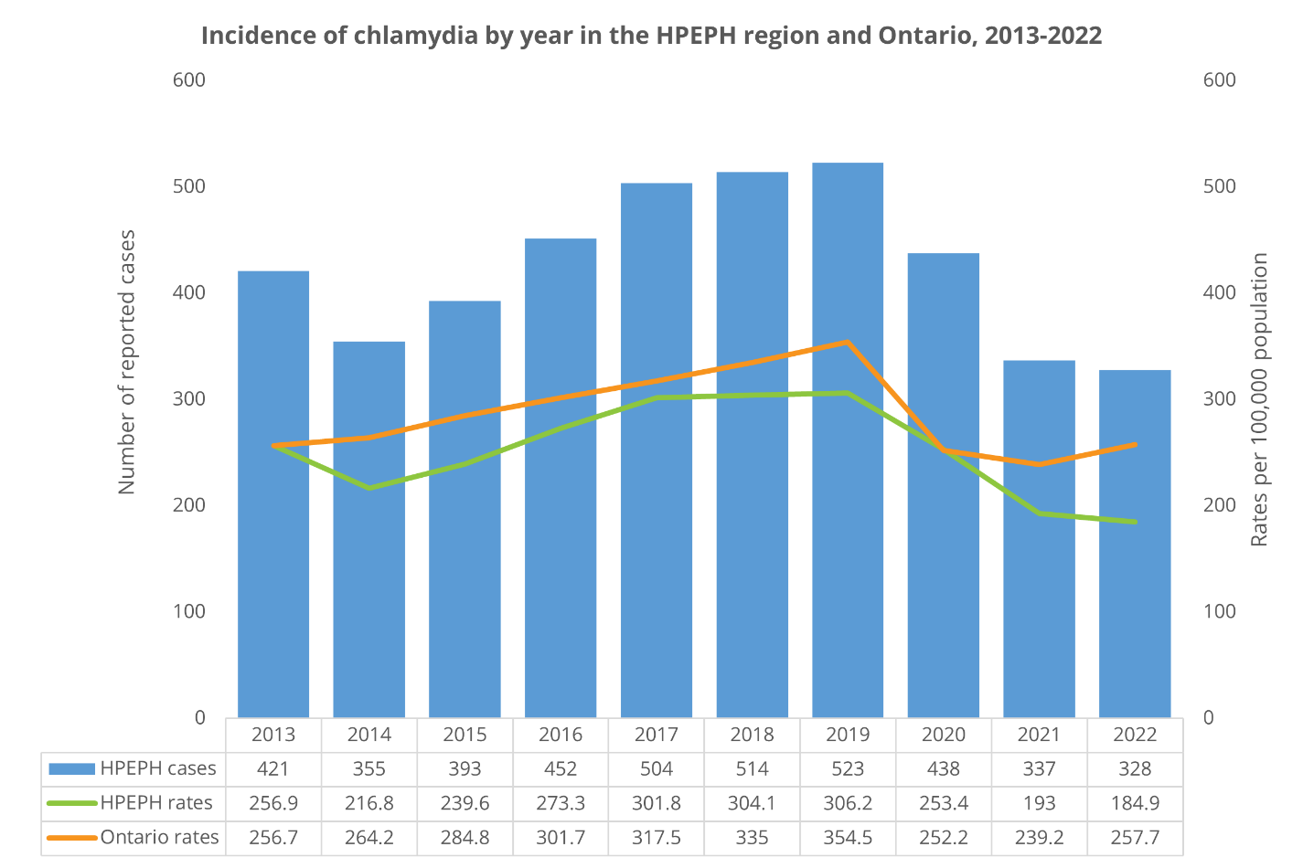
Answer
Chlamydia.
Rates in HPEPH and in Ontario have dropped in the past two years. HPEPH rates remain lower than the Ontario rate.
Back to main board

Slide 91
Question 4
What is the most common way to test for chlamydia or gonorrhea?
The answer is…
Back to topic 1 questions
Back to main board

Slide 92
Answer
Urine test
Back to main board

Slide 93
Question 5
Name 3 possible symptoms
of an STBBI.
The answer is…
Back to topic 1 questions
Back to main board

Slide 94
Answer
No symptom
Odour in genital area
Discharge from penis or vagina
Itchiness around the genitals
Pain in groin
Rash
Swelling of genitals or in groin
Open sore or bumps on penis, vulva, vagina, or anus
Burning or tingling when you urinate
Back to main board

Slide 95
What’s up with that?
Question 1
Question 3
Question 2
Question 4
Question 5
Back to main board

Slide 96
Question 1
True or false?
A person can get more
than one STBBI at a time
The answer is…
Back to topic 1 questions
Back to main board

Slide 97
Answer
True
Back to main board

Slide 98
Question 2
True or false?
It is normal to have some vaginal discharge
The answer is…
Back to topic 1 questions
Back to main board

Slide 99
Answer
True.
The vagina cleanses itself by producing clear to milky white discharge, which can change during the menstrual cycle. If the discharge becomes foul smelling, is increased, or has an abnormal colour or consistency, a health care provider should rule out STBBIs.
Back to main board

Slide 100
Question 3
What is the most common symptom
of an STBBI?
The answer is…
Back to topic 1 questions
Back to main board

Slide 101
Answer
No symptom at all
Back to main board

Slide 102
Question 4
True or false:
A person cannot get an STBBI
the first time they have sex
The answer is…
Back to topic 1 questions
Back to main board

Slide 103
Answer
False
Back to main board

Slide 104
Question 5
True or false:
A person who has only given and received oral sex cannot have an STBBI
The answer is…
Back to topic 1 questions
Back to main board

Slide 105
Answer
False
NOTE: Using a condom or dental dam can decrease the risk for STBBIs
Back to main board

Slide 106
End result
Question 1
Question 3
Question 2
Question 4
Question 5
Back to main board

Slide 107
Question 1
True or false?
All STBBIs can be cured easily
The answer is…
Back to topic 1 questions
Back to main board

Slide 108
Answer
False.
Some STBBIs are easily cured with antibiotics,
but others cannot be cured because they are viruses, so they can only be managed, treating the symptoms but not the infection.
Back to main board

Slide 109
Question 2
True or false?
Most STBBIs go away on their own without
treatment if people wait long enough.
The answer is…
Back to topic 1 questions
Back to main board

Slide 110
Answer
False.
Any suspicion of an STBBI must be assessed by a health care provider. Symptoms could go away while the infection stays and causes further problems.
Back to main board

Slide 111
Question 3
True or false?
A person can transmit herpes (HSV) without having symptoms.
The answer is…
Back to topic 1 questions
Back to main board

Slide 112
Answer
True.
“Up to 70% of genital HSV-2 infections are transmitted when people are not having any symptoms or lesions.”
Reference:
The Society of Obstetricians and Gynaecologists of Canada. Sex & U, STIs [cited 2019 September 4]. Available from: https://www.sexandu.ca/stis/herpes/
Back to main board

Slide 113
Question 4
True or false?
A person who has been treated for chlamydia cannot get chlamydia again.
The answer is…
Back to topic 1 questions
Back to main board

Slide 114
Answer
False.
Even though someone has been treated for chlamydia, they can get chlamydia again, if exposed in the future.
Back to main board

Slide 115
Question 5
Name 2 possible health consequences
of untreated STBBIs.
The answer is…
Back to topic 1 questions
Back to main board

Slide 116
Answer
Sterility and infertility (which means being unable to have children)
Chronic pain
Cervical cancer
Infection risk to newborns
Death
Back to main board

Slide 117
Recommended websites
The Society of Obstetricians and Gynaecologists of Canada (SOGC)
www.sexandu.ca
Kids Help Phone
www.kidshelpphone.ca
HPE Public Health
hpePublicHealth.ca

Slide 118
Sources of support
Parent/guardian
Adolescent care worker/youth worker
Teacher
Guidance counselor
(student services)
Health care provider
HPE Public Health

Slide 119
School health clinics
Birth control and condoms
Emergency contraceptives
Pregnancy or STI testing
Naloxone kits and other resources for substance use
Quit or cut down smoking or vaping
Mental health support
Counselling or referrals for:
  Healthy relationships
  Immunization
  Oral health
  Violence & bullying
  Healthy eating
  Physical activity
Notes:
Limited sexual health services available in ALCDSB schools.
HPEPH school-based public health clinics offer 2SLGBTQI+ supports and services.
School health Public Health Nurses are available in all public secondary schools in Hastings & Prince Edward Counties (once a week during the school year).

Slide 120
Questions?
Notes:
Encourage students to speak with a trusted adult regarding any questions or concerns related to the content covered in the presentation.

Slide 121
References - STBBIs
Sex Information and Education Council of Canada. Sexual health education in the schools: questions & answers updated 2015 Ontario edition [Internet]. Toronto, ON: Sex Information and Education Council of Canada; 2015 [cited 2022 Jul 14]. Available from: http://sieccan.org/wp-content/uploads/2018/05/SIECCAN-QA-Sexual-health-education-in-the-schools-2015-Ontario.pdf
Government of Canada. Booklet: sexually transmitted infections [Internet]. Canada: Government of Canada; 2022 [cited 2022 August 26]. Available from: https://www.canada.ca/en/public-health/services/publications/diseases-conditions/booklet-sexually-transmitted-infections..html

Slide 122
Reproductive
System review
June 2024
Notes:
*This power-point presentation and speaker notes are for educator use only.
Refer to the Sexuality Teaching Kit, Puberty Review section for additional information.
Amaze.org has a variety of videos. *Preview video(s) to ensure alignment with curriculum.
Optional video:
Anatomy: Assigned sex at Birth (Female) (1:51 min) available at: https://www.youtube.com/watch?v=j9QgcCK6FKM
Anatomy: Assigned sex at Birth (Male) (3:06 min) available at: https://www.youtube.com/watch?v=G2ciOhidKpg&t=1s

Slide 123
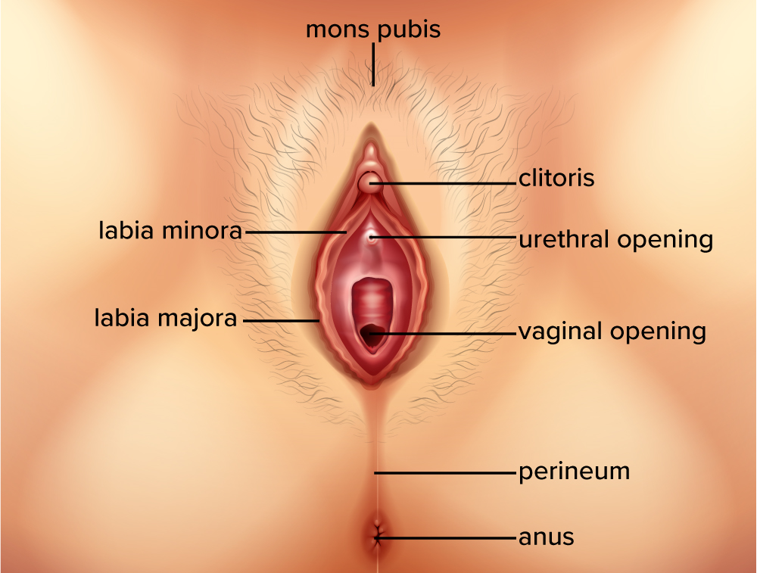
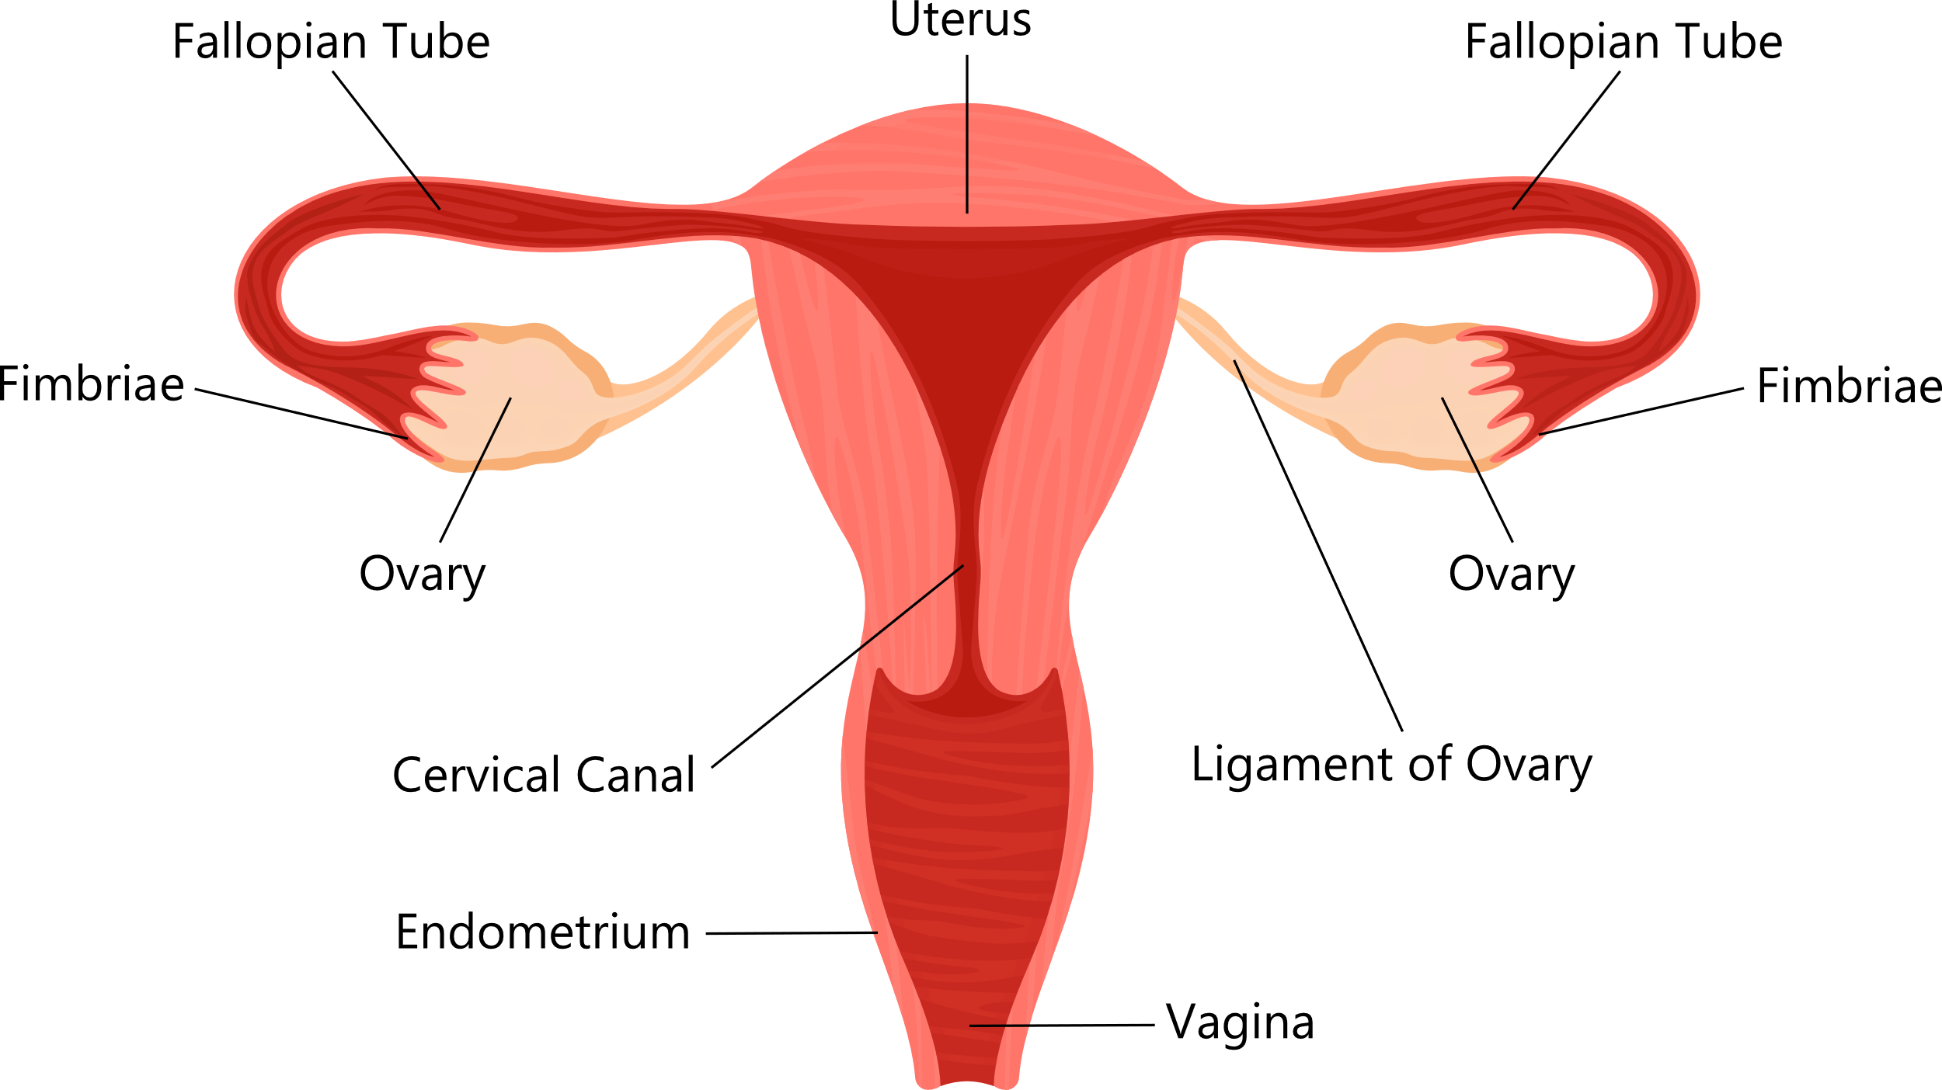
People with a vagina
Notes:
The Sexual Health Teaching Kit contains a Reproductive Anatomy activity with blank images for students to fill in.
Vagina: The vagina is a muscular canal that joins the cervix to the outside of the body. The vaginal opening allows babies and menstrual blood to leave the body.
Cervix: The cervix is the lowest part of the uterus and neck of the vagina.
Uterus: The uterus is a pear-shaped organ that holds a fetus throughout pregnancy.
Ovaries: Ovaries are found on either side of the uterus. They are responsible for producing eggs and hormones.
Fallopian Tubes: Fallopian tubes serve as a pathway for the egg to travel from the ovaries to the uterus. Most often, fertilization of an egg by a sperm occurs in the fallopian tubes. The fertilized egg then moves to the uterus where it implants into the uterine lining. (1)

Slide 124
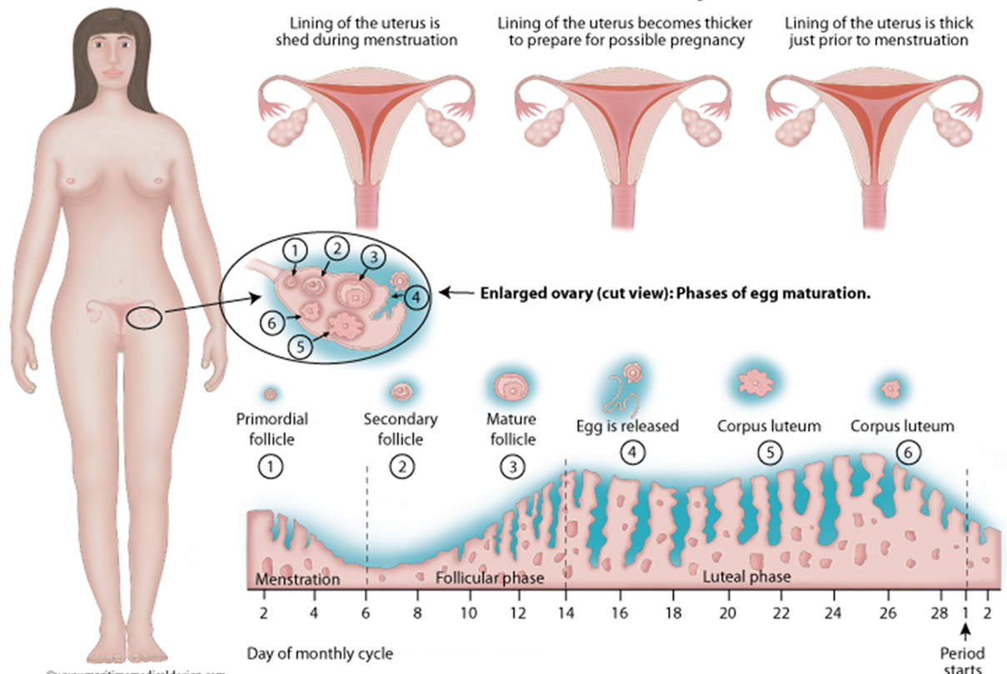
Menstrual Cycle
Notes:
A menstrual cycle is the length of time it takes (an individual with a female reproductive system) for the body to go through the process of releasing an egg, preparing the uterus to cushion a fertilized egg, and then shedding the thickened lining and the unfertilized egg through vaginal bleeding.
The ‘period’ itself is one part of the female cycle. The medical term for getting a period is menstruation or “menses”.
Menstruation usually begins around the ages of 9 to 15. Every person has their own internal clock that determines when the events of puberty begin.
A female’s hormone system controls the menstrual cycle. The changes in a female’s body (including cramps, mood/psychological changes, and a period) are brought on by changes in the levels of hormones that are circulating through her system.
Ovaries produce hormones, especially estrogen, leading to breast development and periods.
Ovaries are filled with many eggs.
At a certain point, the pituitary gland located in a woman’s brain will release messenger hormones, FSH and LH, which “command” the ovaries to release an egg.
If sexual intercourse occurs and the egg is fertilized by a sperm, it leads to a pregnancy.
If an egg is not fertilized, the lining of the uterus, called endometrium, is shed through the vagina, leading to menstruation.
The cycle then begins again. It may take a few years for a young female to fall into a regular pattern of menstruation. Similarly, in the years leading up to menopause (usually around 50, when a female stops ovulating and her period stops), a female’s cycle can also be a bit unpredictable.

Slide 125
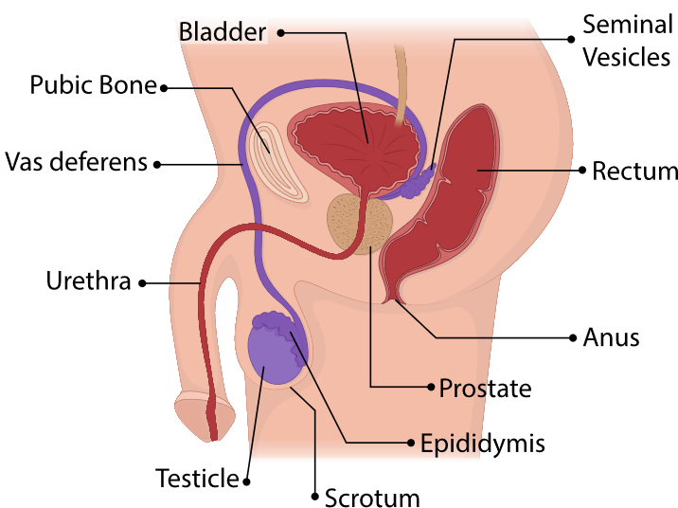
People with a penis
Notes:
The Sexual Health Teaching Kit contains a Reproductive Anatomy Game with blank images for students to fill in.
Testicle: The testicles (or testes) are responsible for making testosterone and producing sperm. Coiled masses of tubes, known as seminiferous tubules, are found within the testes. Their role is to produce sperm cells through the process of spermatogenesis.
Epididymis: The epididymis rests on the backside of each testicle and is where sperm matures.
Prostate Gland: The prostate gland provides fluid that helps nourish sperm.
Seminal Vesicle: The seminal vesicles produce a sugar-rich fluid that gives sperm a source of energy while helping their ability to move.
Vas Deferens: In preparation for ejaculation, the vas deferens transports mature sperm to the urethra.
Scrotum: The scrotum is a loose pouch-like sac of skin that holds the testes, along with many nerves and blood vessels.
Penis: The penis is composed of the root, body or shaft, and glans. The tip of the glans penis contains the tube that transports both semen and urine out of the body. (2)

Slide 126
Questions?
Notes:
Encourage students to speak with a trusted adult regarding any questions or concerns related to the content covered in the presentation.

Slide 127
References
Reproductive System Review
Female reproductive system [Internet]. Cleveland Clinic. [cited 2023 Mar 15]. Available from: https://my.clevelandclinic.org/health/articles/9118-female-reproductive-system
Male reproductive system [Internet]. Cleveland Clinic. [cited 2023 Mar 15]. Available from: https://my.clevelandclinic.org/health/articles/9117-male-reproductive-system

